Slide 1
SETUP
CodeCampDemo solution VS
Font size 150%
Build + Run
Firefox on CodeCampDemo local with mobile useragent
Chrome on CodeCampDemo local
Hit http://mastersband.apphb.com

Slide 2
Responsive Re-Engineering
Aidan Ryan
Silicon Valley Code Camp 2013

Slide 3

About Me
Notes:
I’m Aidan Ryan. I’ve been a software developer for about 9 years. I got started in GWBASIC, then Turbo Pascal, Visual C++, and now C#. Started my career with desktop software and have moved on to the web. Lately I’ve been focused on client-side technologies, especially interested in ASP.NET MVC techniques to push the power of C# into the browser.
Two beautiful daughters and a patient wife
Moved to Bay Area two years ago
Magenic
Started on desktop, m

Slide 4

“Best viewed with IE 5.5 at 800x600, color depth 15bpp, with a parakeet on your shoulder”
Notes:
This topic has been developing over the past 2 years or so. Many people a lot smarter than I have contributed the ideas I am about to present. My intention is to present a survey of current thinking and techniques for Responsive Web Design, and demonstrate their application through a simple case study. We’ll focus on Visual Studio / ASP.NET tools and techniques for getting the job done.
I WILL BE RESPONSIVE TO YOU:
How many people have heard the term?
How many people have a pretty good understanding of what it is?
How many people have used it?

Slide 5
Defining Responsive
Opposite of “prescriptive”
Responds to
Browser capabilities
Device capabilities
User capabilities
Viewport size and orientation
Notes:
The polar opposite of “Best viewed on IE 5.5 in 1024x768 with a color depth of 15bpp”
Prescriptive designs enforce requirements on the browser: they need certain screen sizes, a keyboard and mouse to navigate effectively, or certain plugin support to fully render.
Responsive designs inquire about the capabilities of the consumer (browser/device/user) and put forth the best possible experience given those capabilities. They are fully functional in limited scenarios and enhance the experience as capabilities increase.
Responsive designs respond to
Browser capabilities (HTML5 e.g. audio/video, CSS3, plugins)
Device capabilities (geolocation, resolution, touch vs mouse+keyboard)
User capabilities (accessibility – screen readers, etc)
Viewport size and orientation (on mobile/tablet - resolution [plus density e.g. retina], portrait vs landscape; on desktop – your window is not always full screen)
Term was coined by Ethan Marcotte (writing for A List Apart), co-opting ideas from “Responsive Architecture” – classic example is conference room walls that can adjust opaqueness when projector is turned on.

Slide 6
Core Techniques
Fluid Grid
Media queries
Responsive media
Notes:
Adaptive Grid
Original article names it “fluid”, but this has come to mean proportional, which is not strictly required.
A fluid grid (and a fluid layout in general) provides a framework for smoothly adjusting to window sizes, resolutions, and densities. The earliest fluid layouts were focused on achieving proportional columns using CSS (a technique that was trivial using the common table-based layouts at the time). Further developments of fluid layout are more focused on typography, especially given the emergence of high-density displays that make pixel- and point-sizing even less reliable. A full-scale fluid grid framework (potentially combined with a pre-defined base style set) can be a nice productivity boost.
Media queries
Media queries are a CSS3 feature that allow you to target CSS rules at specific ranges of screen size. *Browser compat
Responsive media
Responsive media is a category of technique that delivers images, video, and audio of the right size/encoding to the right device. In the simplest implementation, right size simply means client-side scaling of an image to fit the layout. Server-side implementations allow us to server smaller payloads to the client as well. (Netflix on-the-fly encoding example)
Notes
It is absolutely not essential to use all of these techniques. Every application is different

Slide 7
Why?
Balance of effort and reach
Consistency
Value first
User joy
Notes:
The sweet spot for responsive design is a balance of development effort and reach: responsive design techniques will get your content in front of the most eyeballs, in a usable way, with the least effort.
Cheapest = design for desktop and cross your fingers on mobile. Lots of mobile users will bounce.
Most Expensive = separate designs for phone, tablet, and desktop. May deliver the most optimal experience on each device, but costs a lot more to develop *and maintain*
You will naturally deliver a consistent experience across devices. Styling, navigation, UX will be familiar and help your users transition. You also have one set of HTML and styling resources to maintain – changing one naturally changes them all.
This approach forces you to first examine the value you’re delivering, then decide how to present it. Tendency when approaching a single platform can be to dive into wireframes before the content is fully realized.
Responsive design is about delivering the greatest possible user joy regardless of the access method. It is not a dogma or a recipe, it’s more of a mindset that is focused on experience first.

Slide 8
Why Not?
Audience
Time/effort to benefit tradeoff
Need for highly-targeted designs
Use a subset of techniques / subset of site
Notes:
Check your logs!
https://gocardless.com/blog/unresponsive-design/

Slide 9
History
Ethan Marcotte – Responsive Web Design
Jason Grigsby – CSS Media Query for Mobile is Fool’s Gold
Approx. 2.9e+9 articles, galleries, samples, etc
May 2010
John Allsopp – A Dao of Web Design
April 2000
April 2013
August 2010
Luke Wroblewski –Mobile First
October 2011
Notes:
http://alistapart.com/article/dao
Letting go of control in favor of accepting and adapting to client differences
http://alistapart.com/article/responsive-web-design
Original articulation of the principles
http://blog.cloudfour.com/css-media-query-for-mobile-is-fools-gold/
First major rebuttal, warning that bandwidth suffers – additional HTML, CSS, and (potentially) JavaScript to render on a smaller screen with *more* code. Important for pivoting the discussion toward general adaptability away from a mobile “silver bullet.”
http://alistapart.com/article/organizing-mobile (from “Mobile First” eBook)
Refinement of responsive design approach working from most-constrained to least

Slide 10
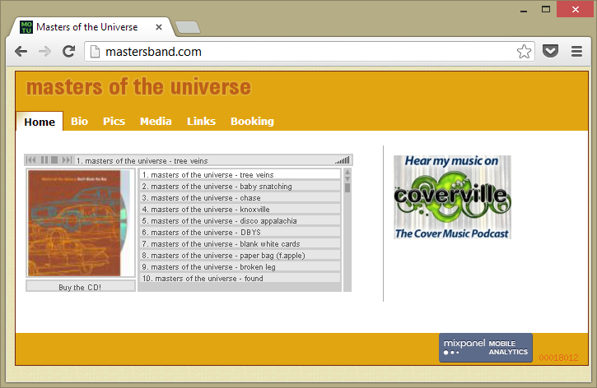
Case Study: Before
Notes:
Content issues
Design issues

Slide 11
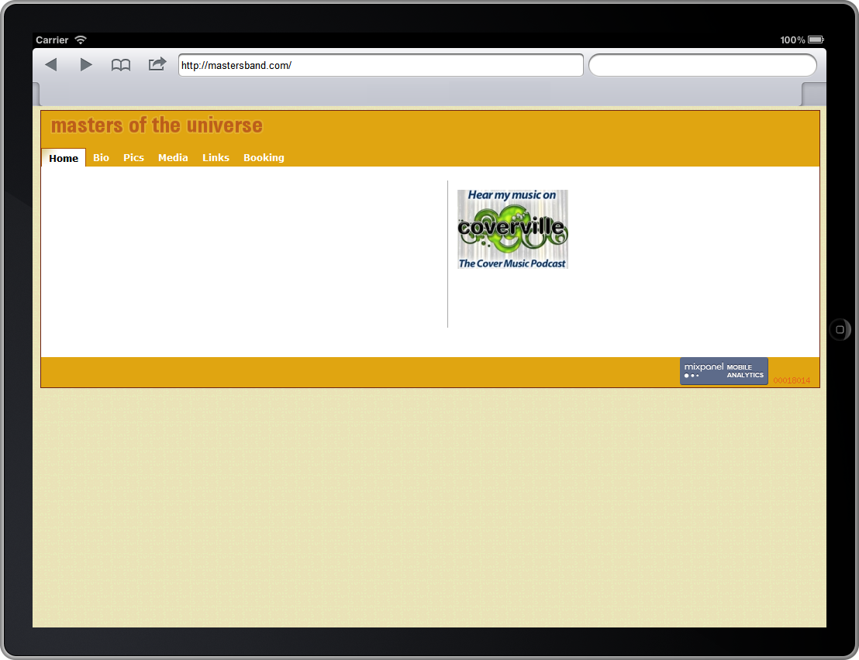
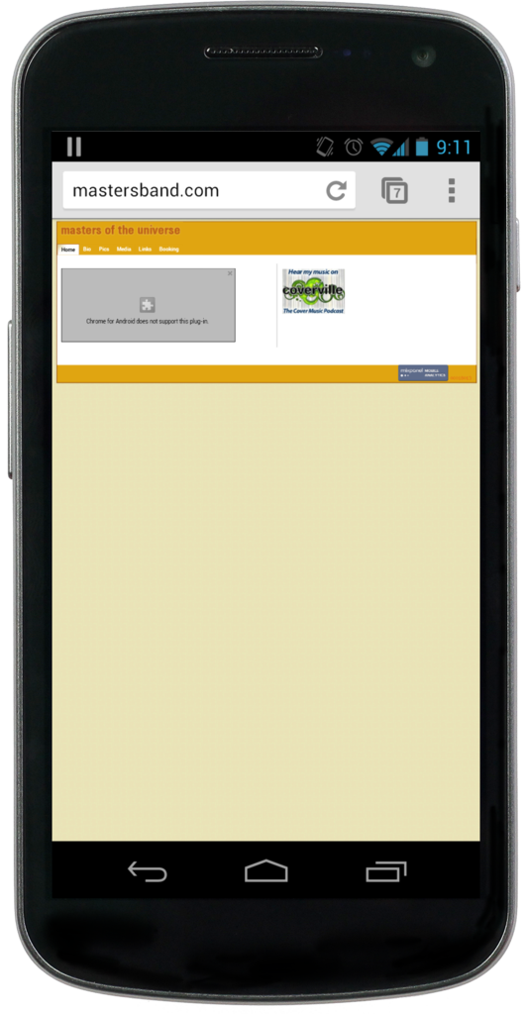
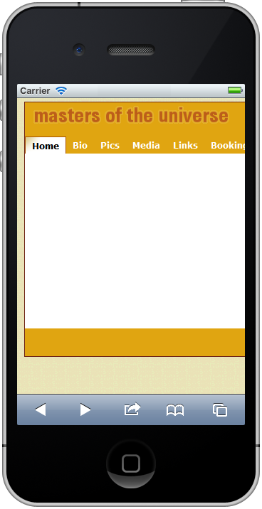
Case Study: Before

Slide 12
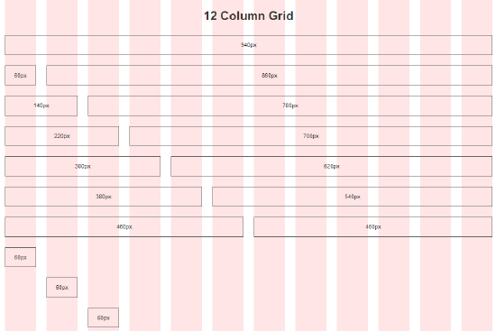
Grid Systems
Fixed
Responsive
Fluid
Fluid + Responsive
Notes:
A grid is defined as a horizontal sectioning of the canvas into columns and gutters. Grids help us think about design, and they help users engage with your content. Think of dynamic guidelines that pop into place as you drag elements around a form designer or PowerPoint slide.
Several frameworks and generators exist that provide grid systems. They fall into four basic categories:
Fixed: the container width is set to a fixed width, and the column count, column width, and gutter width are set to fixed fractions of the container. Column spanning is possible, but the container will never resize with the window.
Responsive: a set of media queries provides a progressive step-down of container width, column count, column width, and gutter width.
Fluid: the column count is fixed; container width, column width, and gutter width are percentages of the canvas
Fluid + Responsive: media queries set the container width and column count; within each breakpoint, column and gutter widths are proportional
Re-using an existing grid framework versus rolling your own – a tradeoff like any other
Bandwidth versus productivity
Customization versus productivity
There are dozens of CSS grid frameworks available, at varying degrees of complexity, maturity, and compatibility. This list selects some notable, popular frameworks that focus on different use cases. New ones are constantly being released that build on principles developed in those that came before.
It can be difficult to adapt existing project to use a CSS framework – they may rely on certain style reset features, typographic assumptions, box-model settings, or other styling techniques that are not compatible with the existing codebase. Even for new work, adoption of a framework can assert a certain identifiable look and feel (see – Bootrap buttons navbar). It is worth spending time customizing the base style to ensure unique branding. This will often require you to learn at least the basics of a CSS preprocessor tool like LESS or Sass.
// TODO: slides w/ static images for each OR scrape and locally-serve their demos

Slide 13
Framework | Classification | Max size | Columns | Notes
960gs | Static | 960px | 12 / 16 | Grid only IE7+ CSS
Skeleton | Responsive | 960px (desktop/tablet-landscape) 768px (tablet-portrait) 420px (mobile-landscape) 300px (mobile-portrait) | 16 | Lightweight CSS framework IE7+ CSS
responsive.gs | Fluid + Responsive | Any Columns stack below 768px | 12 / 16 / 24 | Grid only IE7+ CSS
Bourbon Neat | Fluid + Responsive | Fluid + Responsive | 12 (or custom) | Grid addon to Bourbon IE9+ Sass
Bootstrap | Static OR Fluid OR Fluid + Responsive | Static: 940px Others: Any (nestable) | 16 | Full client-side framework IE6+ LESS
Notes:
Roughly ordered from simplest to more fully-featured.
** Note that responsive features rely on media queries – grids with responsive features will serve either the desktop or mobile view to <= IE8 depending on whether they are “mobile first” or “desktop first.” JavaScript polyfills available for back-compat. Skeleton and Bootstrap are desktop-first, responsive is mobile-first, Bourbon is up to you.
Framework Notes:
960gs – The granddaddy. A good starting point to understand the concepts to launch you toward rolling your own. Viable for sites that are likely to have only desktop traffic. Consider 1140 grid given rise of wider screens.
Skeleton – Relatively minimal and easily customizable. Provides a layout skeleton (output) and CSS skeleton (source) with reset/sane defaults /media-query breakpoints for you to customize.
Bourbon Neat – Relies exclusively on Sass mixins – no classes applied to markup. Extremely customizable.
Responsive.gs – Enforces border-box box-sizing model on all elements.
Bootstrap – Probably the best-known (or at least most buzzed-about) client-side framework available.
Other tools:
Gridset (www.gridsetapp.com) – generates complex grids
Brad Frost / This Is Responsive (http://bradfrost.github.com/this-is-responsive) – basic layout, nav, image, forms, etc; links to resources (tools/frameworks) for RWD
-- DEMO: Responsive gs --

Slide 14
Media Queries
CSS3
All about width
Mobile first? Desktop first?
Select breakpoints
Size, move, hide, replace, or transform?
<meta name="viewport" content="width=device-width" />
@media only screen and (max-width: 40em) {
}
Notes:
Media Queries are a CSS3 feature and not supported on all browsers (browser support addressed overall later) – main caveat is IE9+, polyfill for lower IE
Width, width, width.
Everyone expects to scroll vertically
Mouse wheel conventions
Text wrapping
Thank goodness the web doesn’t have fixed-height pages like a book!
Choosing mobile or Desktop first:
Mobile First: progressive enhancement
Desktop First: graceful degradation
The mobile/desktop first question is influenced by:
Is there an existing site? What is its target?
Audience breakdown – device and size (server logs can be misleading – if your mobile experience stinks, people aren’t returning. Unique IP better measure than views):
Mindset / preference
Selecting breakpoints
CONTENT is king. It’s not possible to select and design around a set of device-based breakpoints. CSS will be heavy and under-performing, compromises will be made to “Fit in the box.” Better to evaluate your content and think in general terms about presenting it in “big”, “middle”, and “small” contexts.
Min-width / max-width / both
Snapped on a Surface
Line length is important, CSS3 multi-column can help.
Scaling out from base-font em maintains design across user-selected fonts, zoom, display densities
Knowledge of common device widths is useful (along with testing the site on biggest-marketshare devices), but
Size, Move, Hide, Replace, or Transform?
Size: shrink box and/or font
Move: reposition an element (most commonly moving columns to stacked)
Hide: remove entirely
Replace: provide the same function in a smaller package (common example – nav menu)
Transform: maintain the same markup but change its initial presentation (e.g. full content dropping down to an accordion)
Depends on the semantics of the element
May descend from size > move > hide at cascading breakpoints
Remember most-important content should come first in markup for accessibility SEO (see grid system push / pull classes)
Server-side mobile refinement
NuGet 51Degrees.mobi for better device detection – directly modifies Request.Browser.IsMobileDevice and supplies many additional capabilities
DetectMobileBrowsers.com regex for simple useragent detection
Remember mobile bandwidth! Content hidden with display:none is still downloaded.
*DEMO MVC hiding in view, with corresponding output cache attribute*

Slide 15
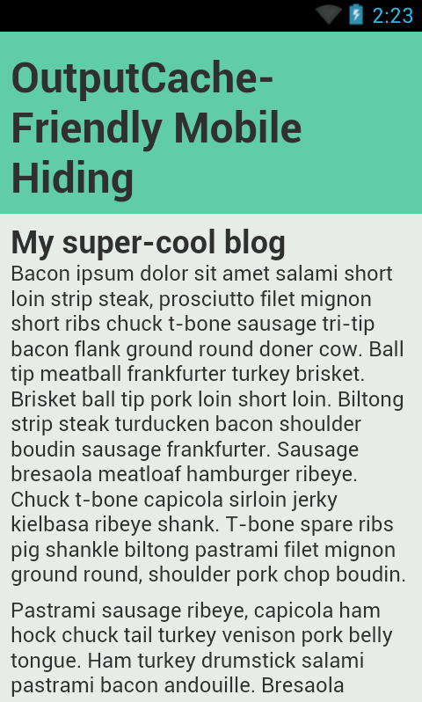
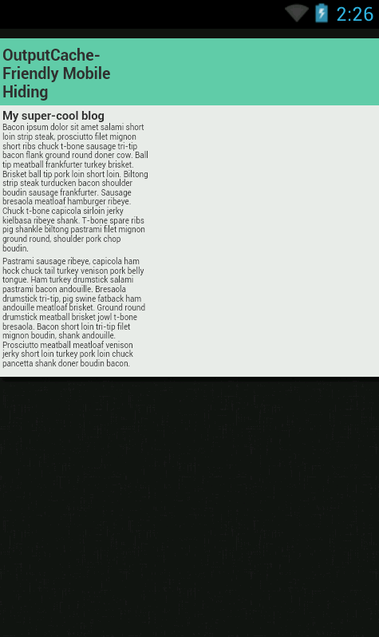
Viewport
width=device-width Defaults
Notes:
+++Layout Viewport
CSS pixels available to layout
Desktop resize window resizes the layout viewport
Mobile layout viewport is set at load and does not change (exception: scroll bars)
Mobile devices play some extra tricks with text wrapping – divs will lay out correctly but the wrap point may be adjusted based on double-tap zoom size; text may re-wrap on zoom as well
Visual Viewport
The visual viewport is the CSS pixel dimension of the visible area of the page
Desktop resize window resizes the visual viewport
Mobile zoom resizes the visual viewport
QUIZ: On the desktop, what will make the layout and visual viewports different?
Scrollbars
Viewport meta-tag for Mobile
Controls the layout viewport
Determines the number of device pixels per CSS pixel at zoom = 1 * this is the important concept to get your head around *
99% of the time, use the <meta name=“viewport” content=“width=device-width”> tag
Default iOS and Android layout viewport width is 980 CSS pixels, with initial scale set to match the visual viewport
Content attribute is comma-separated
Width = [px|device-width]. Device width is “screen width in CSS pixels at 100% zoom”
Height – little-used
Initial-scale = multiplier
Maximum-scale = multiplier
User-scalable = [true|false]. Whether to allow the user to scale
CSS 2.1 recommends that CSS pixels correlate to one 96dpi pixel at arms’ length; initial-scale=1 requests this
IE10 METRO: ignores the viewport meta tag in Snap!
Need
@-ms-viewport {
width: device-width;
}
Relevance to media queries:
width versus device-width
99% of the time you want width (CSS pixels)
Device-width can help you target specific devices (e.g. iPad|Phone)
Note iOS reports *portrait* device-width & -height regardless of orientation (use orientation to differentiate)

Slide 16
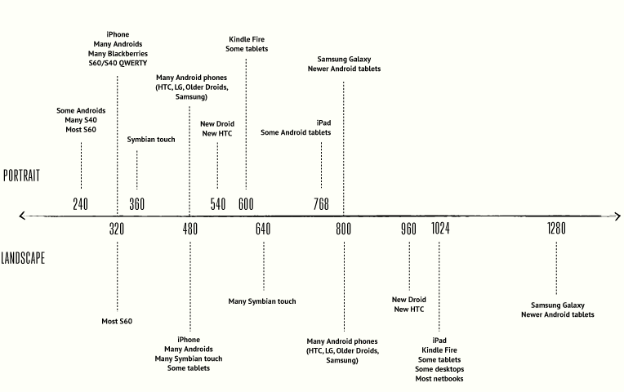
Credit: Viljami Salminen
Notes:
There are WAY too many devices to design to device-specific breakpoints. Choose too narrow a width & get cut off on slightly larger devices; choose too large a width and serve a shrunken layout on a device that can handle more…
The sweet spots are generally in the circled areas – let your content be your guide.

Slide 17
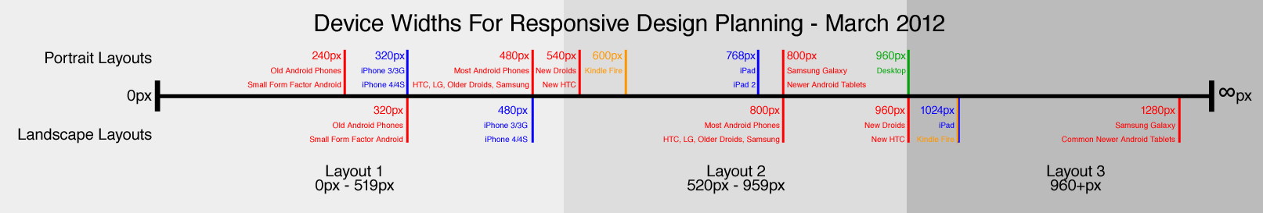
Three…
Credit: Adam Edgerton

Slide 18
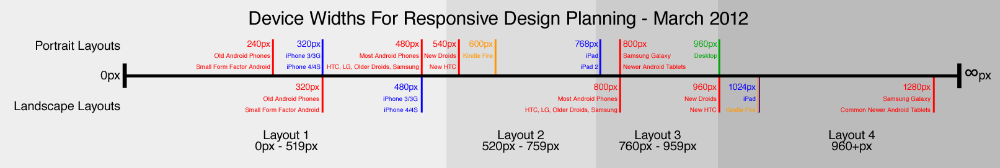
Four…

Slide 19
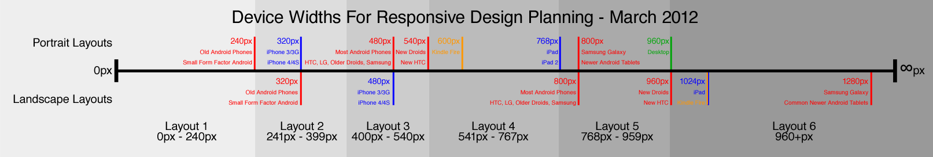
Six…?!?!

Slide 20
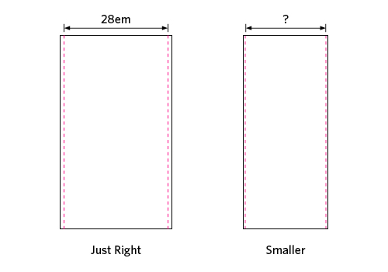
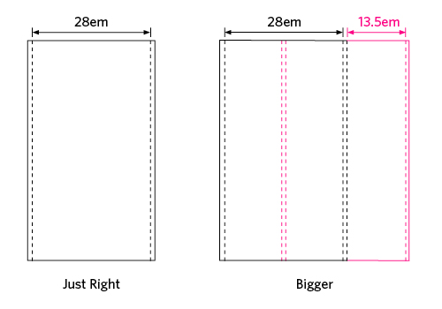
The “Goldilocks” Approach
Credit: Chris Armstrong
Notes:
** NEED A NEW PICTURE **
Choose a starting point (Really BIG or Really SMALL) and start resizing until things look “wrong”
Set a breakpoint, fix it
Repeat
Three sizes is a maintainable sweet-spot
“Goldilocks Approach” (Chris Armstrong)
Content-out, not canvas-in
Going content-out means respecting the default base font size and scaling from there in em (side-trip into meaning of em)
Need to know some basic metrics: around 66 characters per line, ~30em is optimal for eye scanning from end-of-line to beginning-of-next
Set max-width of main text content to 30em
With a “too big” screen, add text columns
With a “too small” screen, remove margins and hanging elements
Em units are density-independent (think retina)

Slide 21
Responsive Media
Images
Scale, crop, swap, omit?
SVG
Video
Scale
HTML5 <video>, Flash
Download alternatives
Audio
Scale
HTML5 <audio>, Flash
Download alternatives
Notes:
Audio: supply MP3 and OGG, and fall back to Flash or a direct download link.
http://media.io will do conversions for you

Slide 22
Responsive Images
Scale and Crop
Swap and Omit
SVG
Choose the right format
Encoding quality
Notes:
Scaling:
Basic image scaling can be accomplished with width: 100% and max-width. IE7 has issues and will crop. (DEMO)
Cropping:
Negative margins inside a container with overflow: hidden (DEMO)
Swap / Omit:
Avoiding download
Textures are a good candidate
Swapping images can be accomplished client- or server-side
Client-side with <noscript> approach
Server-side with an HTTP Module like ImageResizer (with responsive presets - https://github.com/mindrevolution/ImageResizer-ResponsivePresets)
Server-side with useragent-aware URL selection (DEMO)
SVG
Infinitely scalable at 100% quality
PNG fallback for IE (DEMO – note browserstack or VM – IE7 mode of IE10 does not show fallback)
Other Bandwidth Tips:
Choose the correct format! (PNG – logos/vectors; JPEG photos / realism; GIF – for <=IE6 PNG transparency workaround OR use CSS hack)
Losslessly optimize your PNGs (PngGauntlet) and others (plenty of tools)
Image gallery: photoswipe.com

Slide 23
Responsive Video
<div id="video-container">
<video controls="controls" width="1280" height="720" title="vid" poster="x.jpg">
<source src="small.mp4" type="video/mp4" media="all and (max-width:480px)" />
<source src="file.webm" type="video/webm" />
<source src="file.mp4" />
<object …>
<a href="file.mp4“><img src="x.jpg“/> Download video</a>
</object>
</video>
</div>
$('#vid-container').fitVids(); // OR CSS
Notes:
Performance + Compatibility - HTML5 video with Flash fallback
Supply VP8- and H.264-encoded files and you will cover nearly all user agents
Omitting the type from the final source will cause most browsers to check the metadata to determine if it can be played. Bandwidth/accessibility tradeoff.
*could* use the little-known media attribute to serve smaller files to smaller devices (caveat: this may be dropped)
IIS NOTE: need to add mime types for video. You’ll get a 404.3 without it. (Web.config \ system.webserver\staticContent\mimeMap)
Good resources
Mark Pilgrim’s excellent, very in-depth (though getting out-of-date) guide: http://diveintohtml5.info/video.html
Concise, easy to read guide from JWPlayer: http://www.longtailvideo.com/support/jw-player/jw-player-for-flash-v5/22644/using-the-html5-video-tag/
Within the video tag, below the sources, include a flash fallback and video download link (for users without flash)
FlowPlayer is a nice option (note issues with FlashFox resizing)
Within the object tag, supply a final fallback download link for devices with neither video NOR plugin support
Nice tool for generating markup: “Video for Everybody” http://camendesign.co.uk/code/video_for_everybody
Use JavaScript and/or HTTP module and user agent detection to serve appropriate codec and filesize
Third-party
Don’t discount the option of hosting the video externally (Vimeo, Youtube) and IFRAMEing in a player – they’ve solved the cross-browser issues and will take bandwidth & connection pressure off your server.
Flexible sizing:
For the <video> tag, you can rely on width = 100% and max-width, with height auto to flexibly resize video while maintaining aspect ratio
Flash and IFRAMEs have issues – can’t automatically set height to preserve the aspect ratio.
Thierry Koblentz “Creating Intrinsic Ratios for Video” to the rescue - http://www.alistapart.com/articles/creating-intrinsic-ratios-for-video/
Set a wrapper DIV with relative position, zero height, and bottom-padding representing the aspect radio (e.g. 56.25% == 16:9)
Set an inner div absolutely positioned with 100% width and height
This technique has issues in IE7 and below – use a conditional style sheet
DEMO

Slide 24
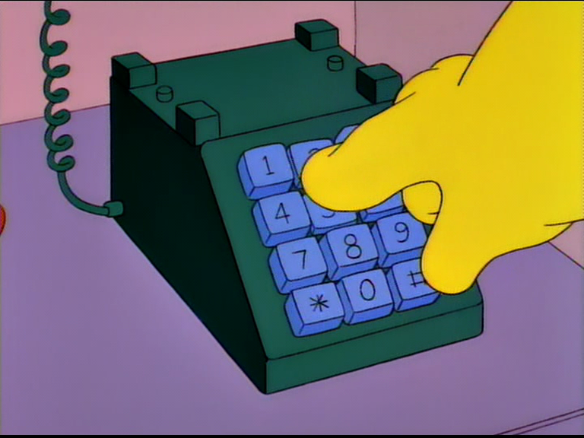
Responsive Forms
Label alignment
Touch-friendly
Input types
“To order a special dialing wand, please mash the keypad with your palm now.”
Notes:
Note “field zoom” feature of many browsers –
makes top-aligned labels better, otherwise label or field may be cut off
Input { font-size: 1em } to avoid extra zoom on iDevices – lower font will zoom
Touch-friendly
Sizing (finger targets)
Click versus Touch events (WARNING re-fire. See FT Fastclick http://labs.ft.com/articles/ft-fastclick/)
Input Types
To show special keyboard layouts - Email, url, tel, etc.
WARNING – may apply some browser-native validation
DEMO
Use BrowserStack for virtual keyboard;
show double-touch fire in electric plum and then un-comment preventDefault)

Slide 25
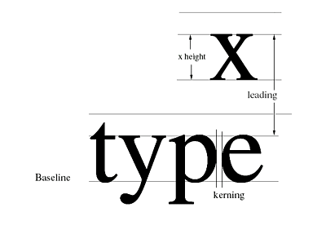
Typography
Respect the user agent
Display density
Metrics: font size, contrast, line height, line length, spacing, hyphenation
“A useful trick is to hold a well-printed book at a comfortable reading distance while looking at your website to compare.” – attrib
Web fonts – browser and device quirks
Source: BrightLemon.com
Notes:
The user (or at least platform developer) has already specified his/her preferred default font size. Rather than overriding this, we should respect it as a base and scale from there.
Pixel density
New “retina”-class devices and HD displays can make pixel sizing unreliable, and the future of the “pixel” is uncertain
Adjusting weight by density to achieve a uniform result (as density increases, use a bolder weight to achieve same perceived weight)- relates to antialiasing
On standard-density displays, serif fonts below 12px are not sharp enough. But you should be over 12px anyway.
Metrics
Font size: bigger than you think. Hold a book or magazine at a comfortable distance and compare.
Contrast: ratio font color to background brightness. Steer clear of full black (looks like a “hole”) and full white.
Line Height: for text, 140% of font size is a good general rule, but depends on face (ascender/descender ratio to x-height and “blackness”); proportional line-height (font: Arial 1em/1.44) with no units
Line Length (measure): From 45 to 75 characters is good balance of ease in tracking to next line vs not having to do it too often. When browsers support it, you can use CSS3 column count when the view gets very wide. You can leave width “on the table” and set a max-width; also want to ensure text blocks have good height in proportion to width.
Spacing: Headings can often use more space to breathe
Gotchas
Note that when using fluid (proportional) layout techniques you give up some control over line length
Web Font browser quirks
Rendering differences
Format support
Web Font mimetype if serving locally (chrome console complaints)

Slide 26
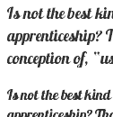
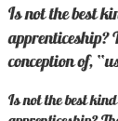
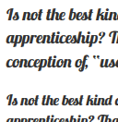
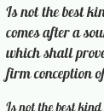

Fonts – Browser Quirks and Gotchas
Chrome 23 IE10 Firefox 16 Android 4.1
Selected text-shadow
Notes:
FontSquirrel for free webfonts and known-good CSS

Slide 27
Other Techniques
Mobile click event latency (touch events)
Keyboard hotkeys
Bundling and minification (System.Web.Optimization)
Notes:
Click latency: demoed on form
Hotkeys: demo
Bundling and min: debug/release demo

Slide 28
Case Study Workflow
Value
Content
Wireframe
Enhance, enhance, enhance

Slide 29
Case Study: Before

Slide 30
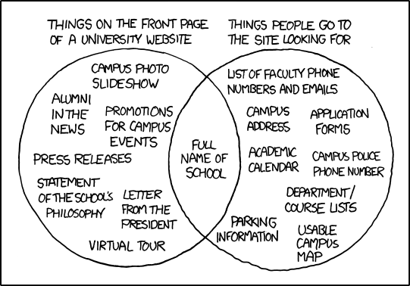
Step One: Focus on Value
Identify your user
Identify the primary reason the user is visiting
Identify the activities that will engage the user
http://xkcd.com/773/
Notes:
Tag each activity with the device(s) where it is likely to be performed. A general rule is that desktop and notebook users can create while tablet and phone users will mostly consume. Certain activities may simply not be feasible on mobile devices. It’s acceptable to deliver simplified, read-only

Slide 31
Case Study Step One
Users
Repeat visitors
Organic search
Active search
Reasons
Repeats: hear old and new sounds
Organic searchers: He-Man
Active searchers: hear sounds, read info
Activities
Play music
View pictures
Read copy
Notes:
Items are ordered by rough probability / priority

Slide 32
Step Two: Collect Content
Isolate your copy
Curate your copy
Isolate your media
Curate your media
Process your media
Notes:
Process: don’t forget metadata
Content ideas: before/after

Slide 33


Slide 34
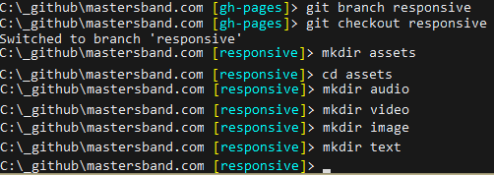
Notes:
Big content buckets
Bulk sort
Inspect and trash judiciously. You will discover stuff you forgot you had!

Slide 35
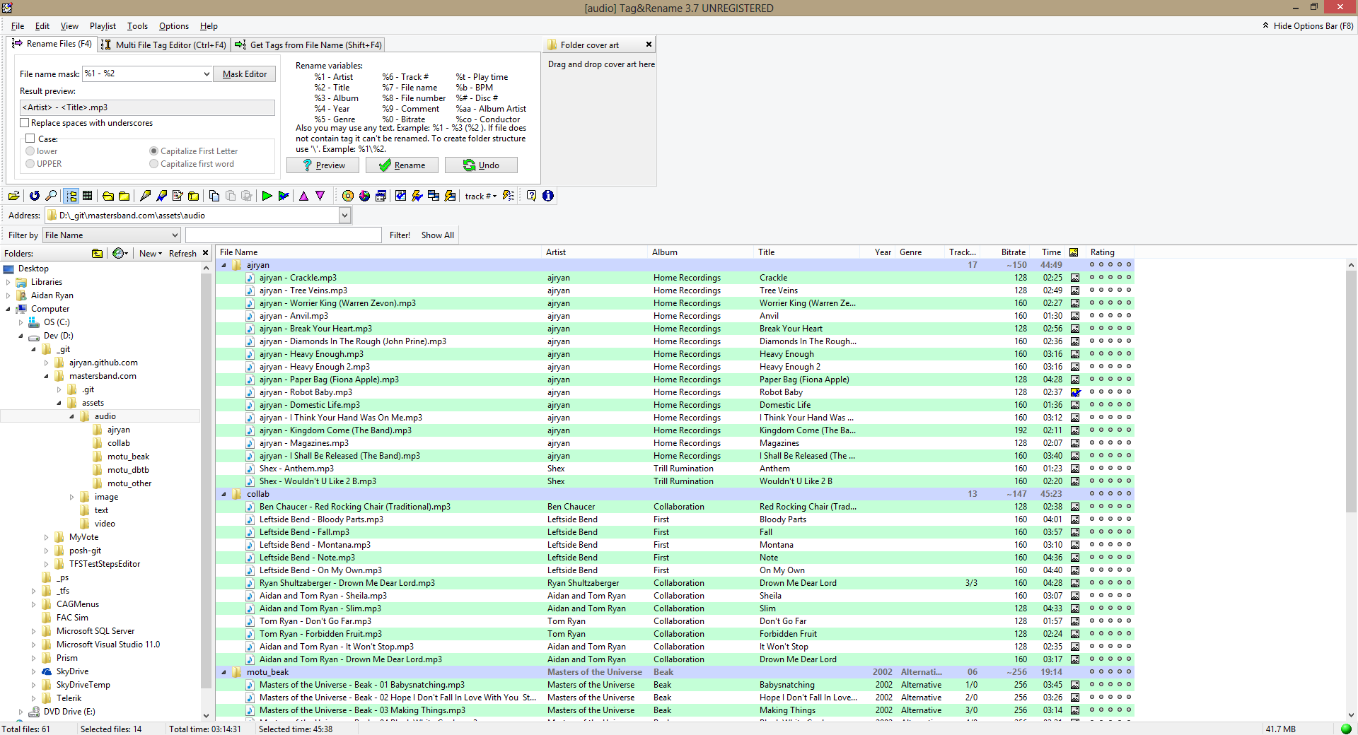
Notes:
Don’t forget metadata. Tools help here!
Fotosizer for batch image resize

Slide 36
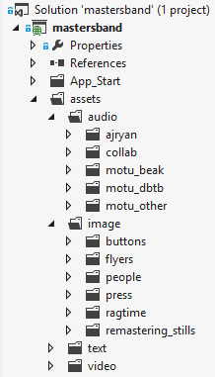
Case Study Step Two: Result
Copy: isolated, culled, consistently named
Image sets: sorted, culled, consistently named, full-size and scaled
Audio: sorted, culled, consistently named, with ID3
Video: full-bitrate and downsampled

Slide 37
Step Three: “Sweet Spot” Wireframes and Typography
Index card sitemap
Paper sketches / storyboard
Move to HTML Skeleton ASAP
CSS Reset
Type ramp
Notes:
Taking the “goldilocks” approach and ignoring any specific width
Type plays a very prominent role in responsive design. Early decisions about type will make your layout decisions easier and reduce future rework.

Slide 38
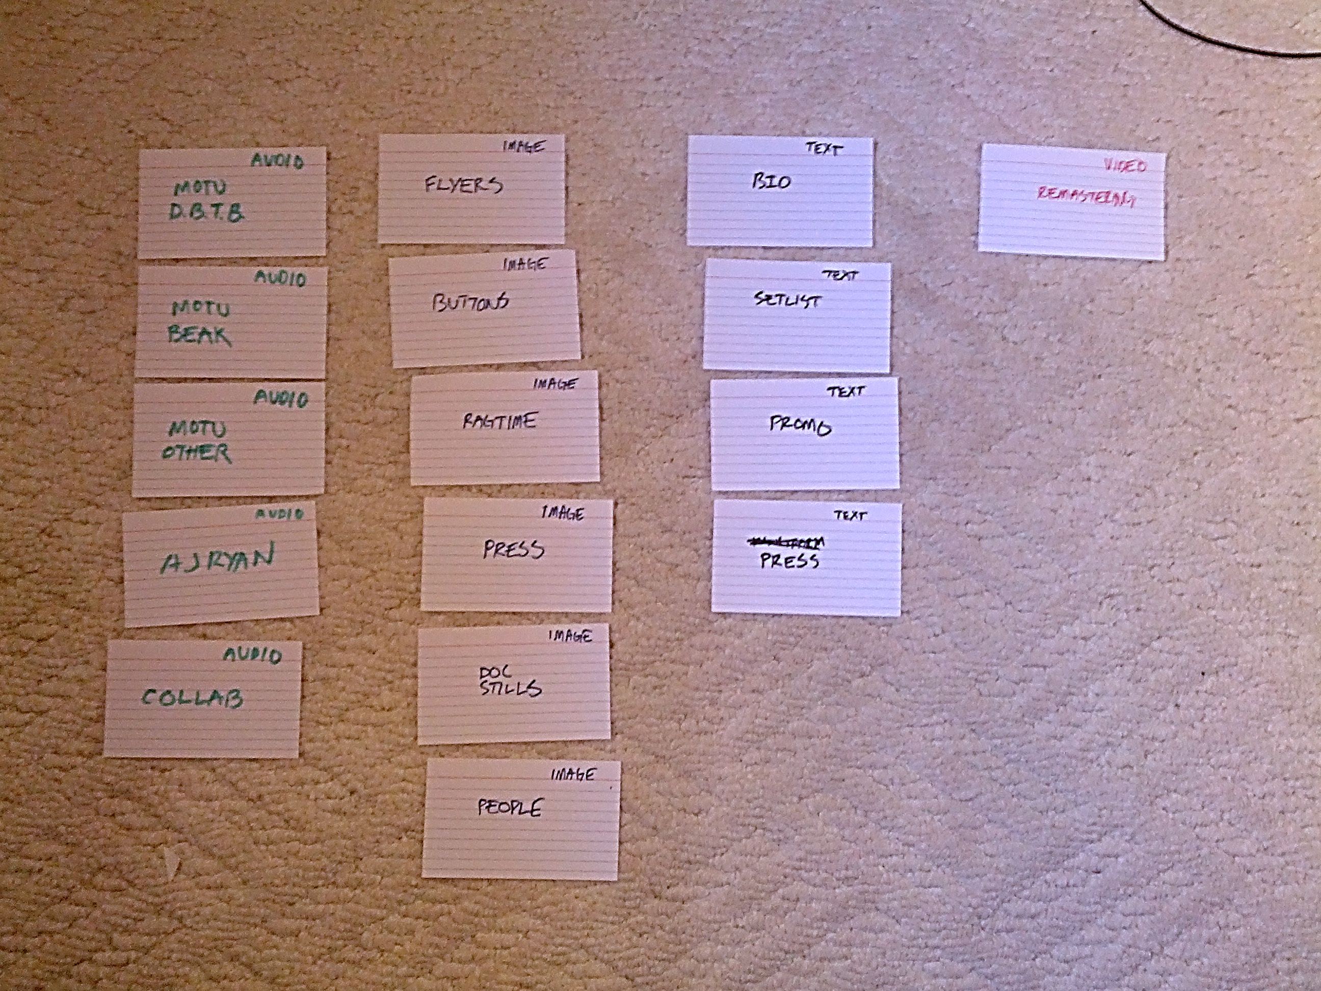

Slide 39
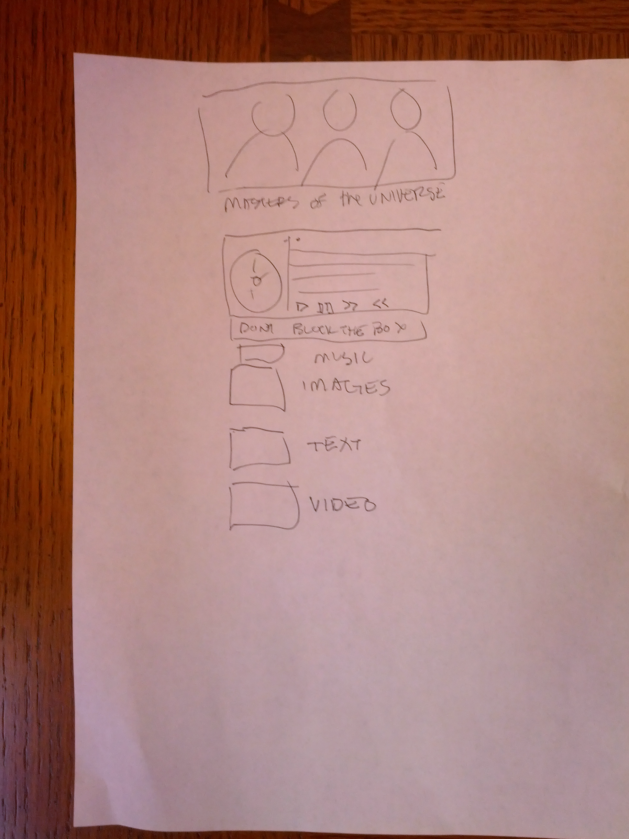
Notes:
First rough

Slide 40
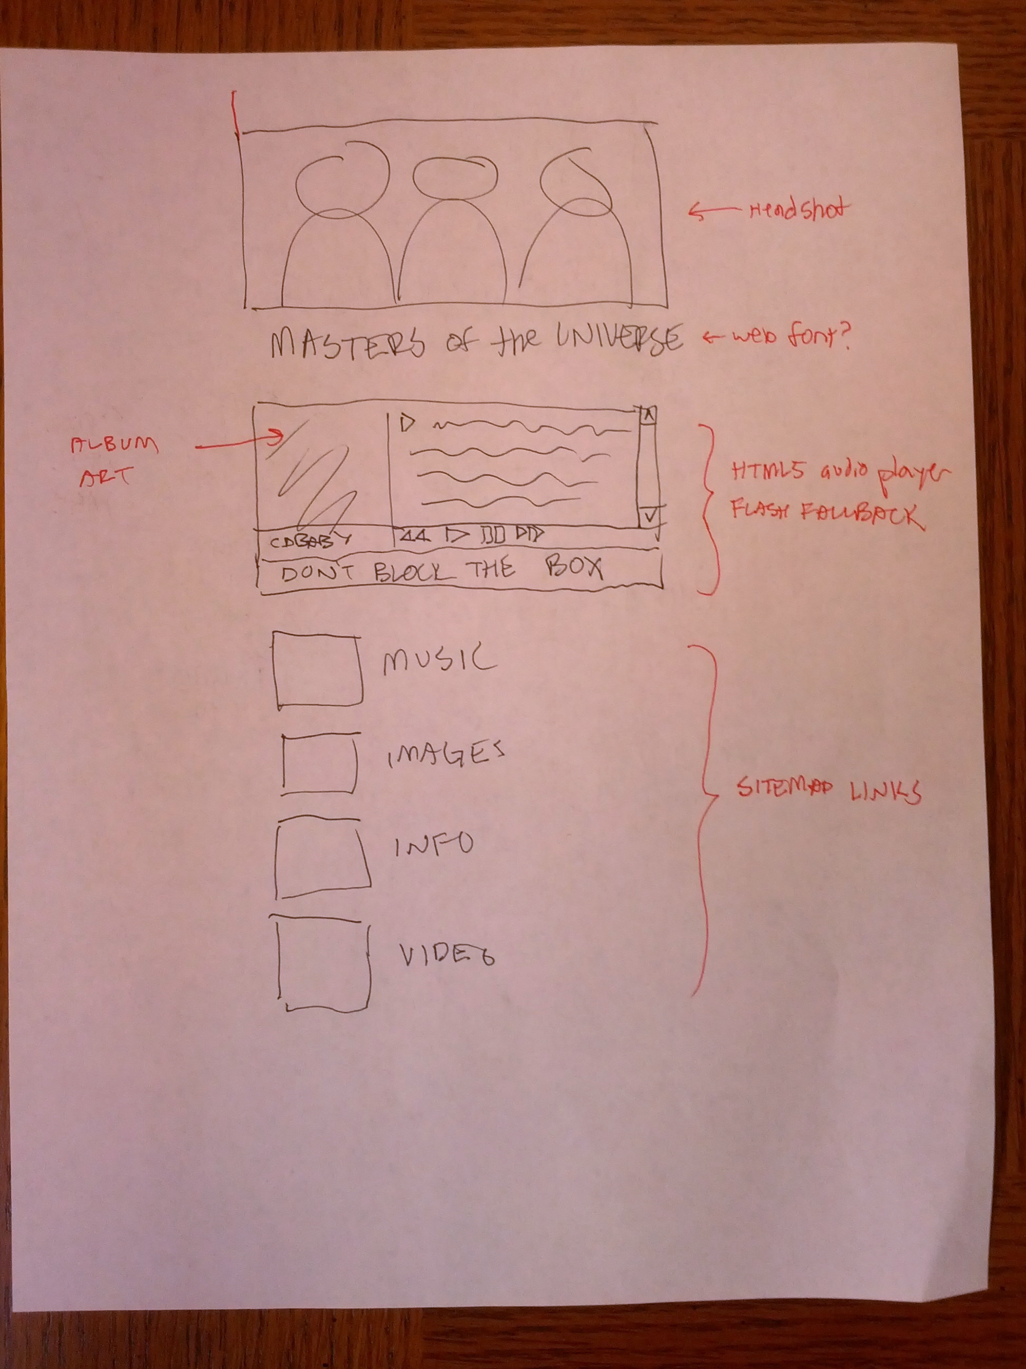
Notes:
Refine

Slide 41
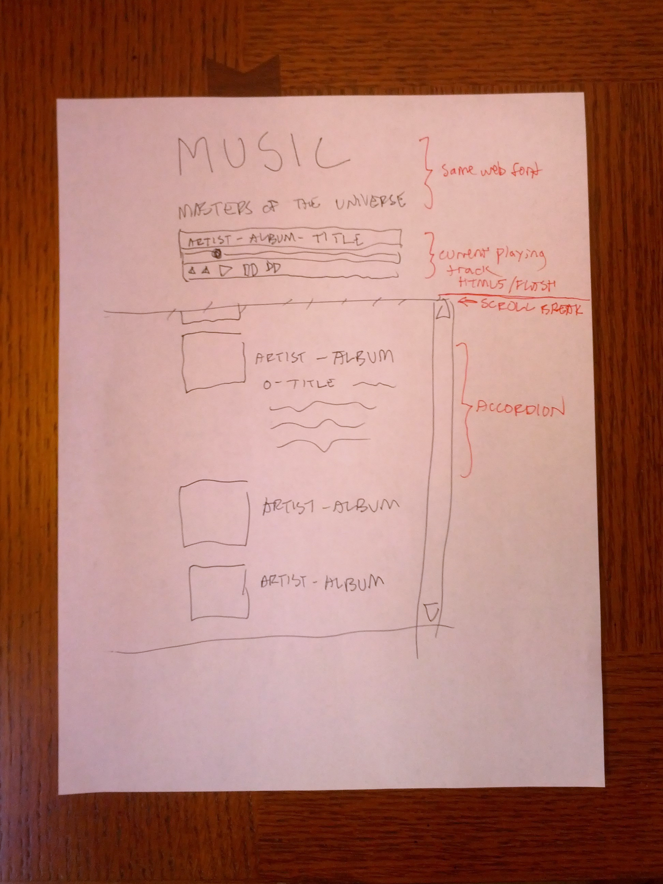
Notes:
Interior

Slide 42
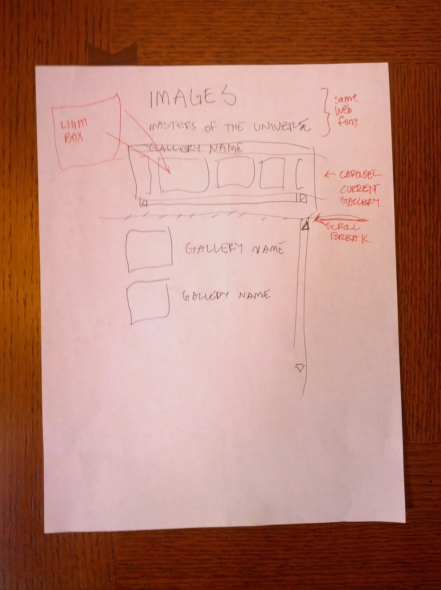
Notes:
Interior

Slide 43
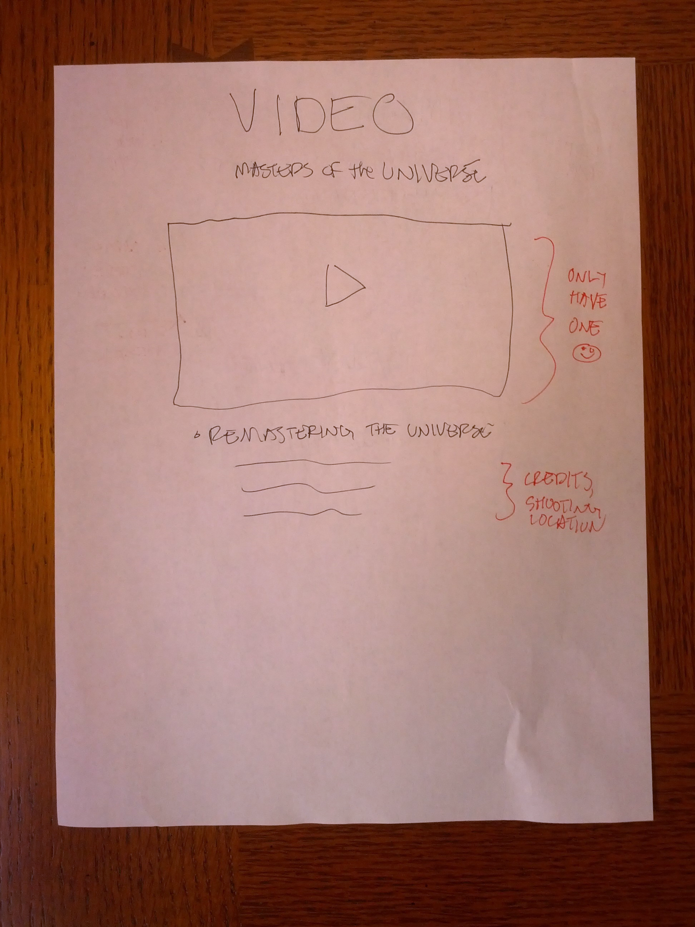
Notes:
Interior

Slide 44
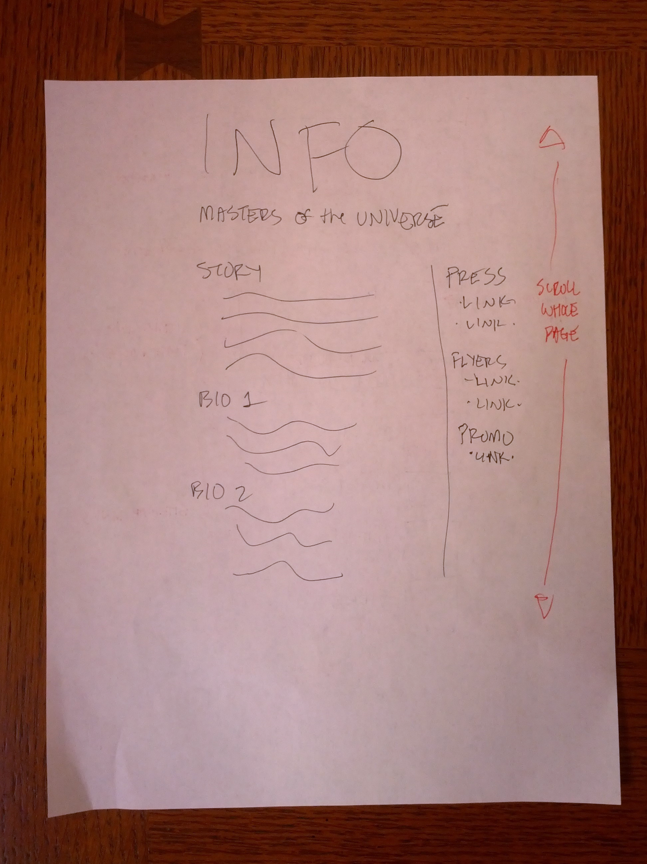
Notes:
Interior

Slide 45
MVC 4 Skeleton
Start with “Empty” project
Strip out Web API and other unneeded NuGet packages
Add the master layout
Style bundle (normalize.css + site.css)
HTML5shiv
Minimal layout

Slide 46
@using System.Web.Optimization
<!DOCTYPE html>
<html>
<head>
<meta charset="utf-8">
<meta http-equiv="X-UA-Compatible" content="IE=edge,chrome=1">
<meta name="viewport" content="width=device-width">
<title>Masters of the Universe</title>
@Styles.Render("~/CSS/styles")
<!--[if lt IE 9]>
<script src="~/JavaScript/html5shiv.js"></script>
<![endif]-->
</head>
<body>
<div class="page-center">
<header>
<div class="hero">@RenderSection("hero", true)</div>
<h1 class="logo">Masters of the Universe</h1>
</header>
@RenderBody()
</div>
</body>
</html>

Slide 47
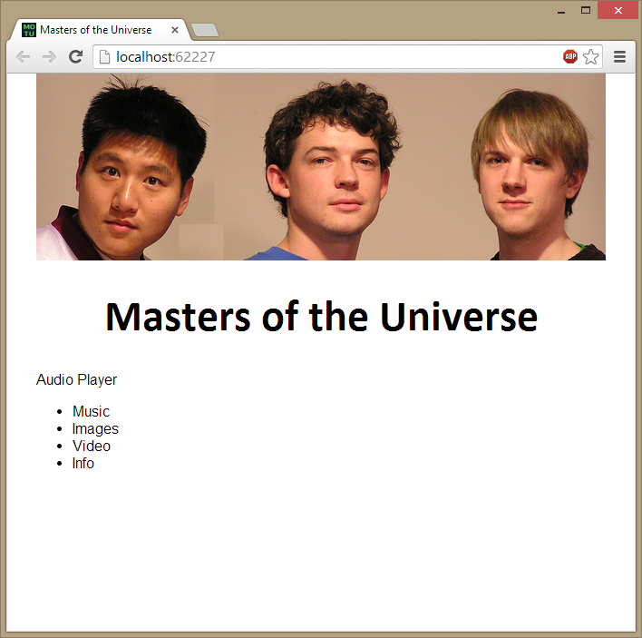

Slide 48
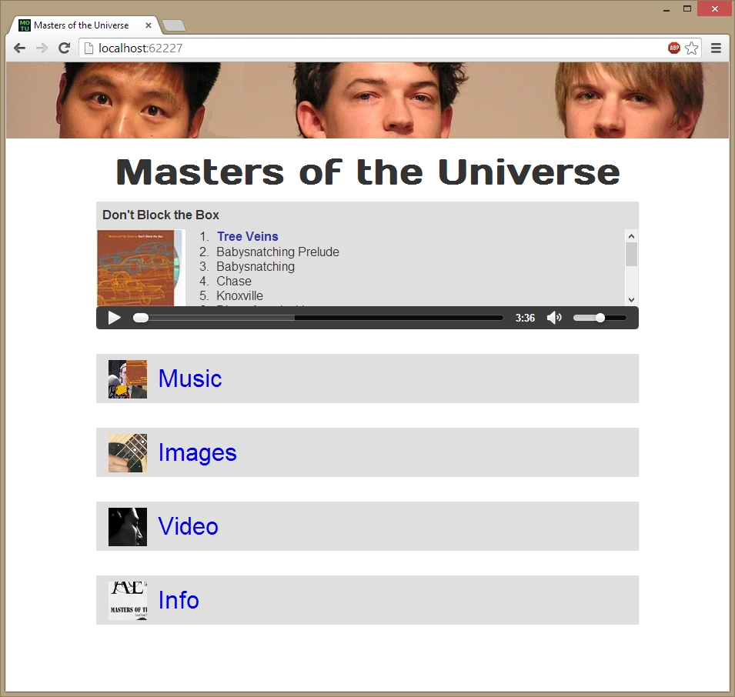

Slide 49
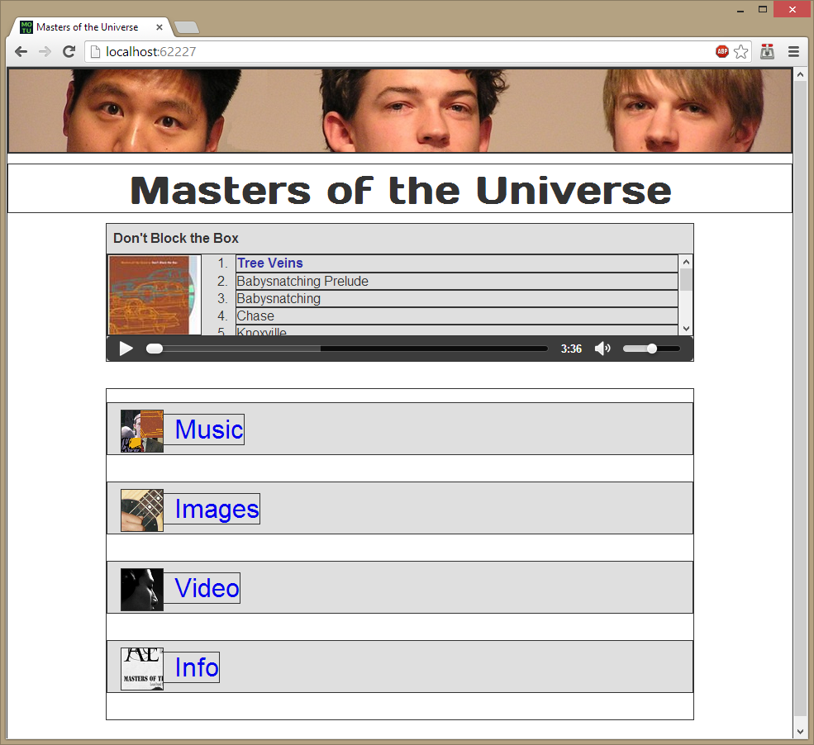
Notes:
Develop a skeleton with minimal nesting that will allow for simple reflow/positioning.

Slide 50
Step Four: Enhance Layout for Mobile
Position
Type Size
Padding/Margins
Remove non-essentials
Notes:
51Degrees Request.Browser

Slide 51
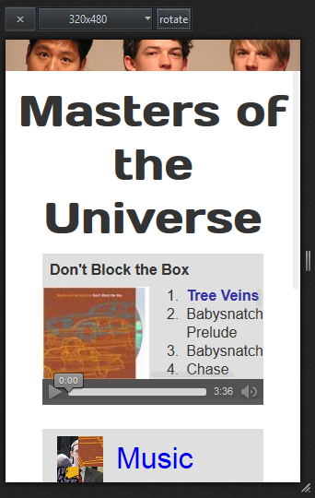
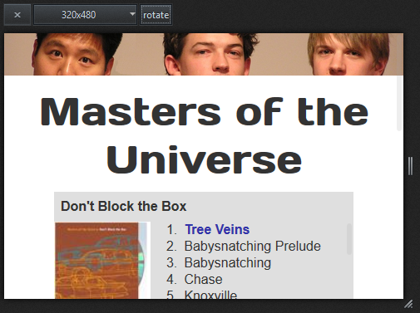
Before
Notes:
Head is stealing space
All fonts can drop size (need mobile ramp)
Margins stealing from player
Margins too big on menu links

Slide 52
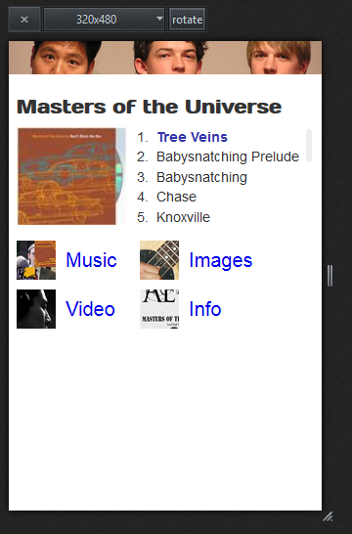
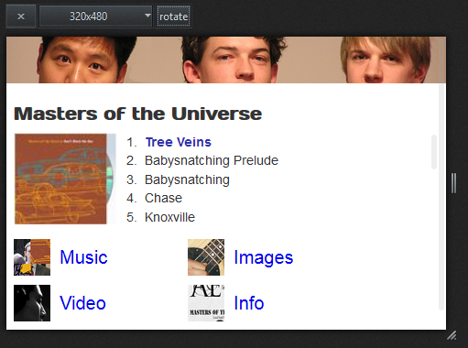
After
Notes:
51degrees removed audio controls – can’t do w/ CSS; JavaScript play/pause on the album cover. Later enhance will do a glyph overlay
No scrollbars at smallest mobile.

Slide 53
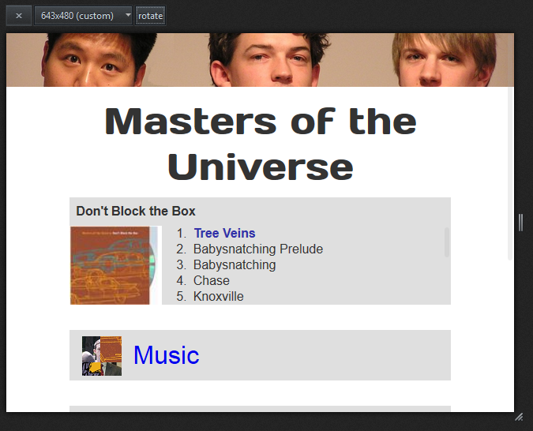
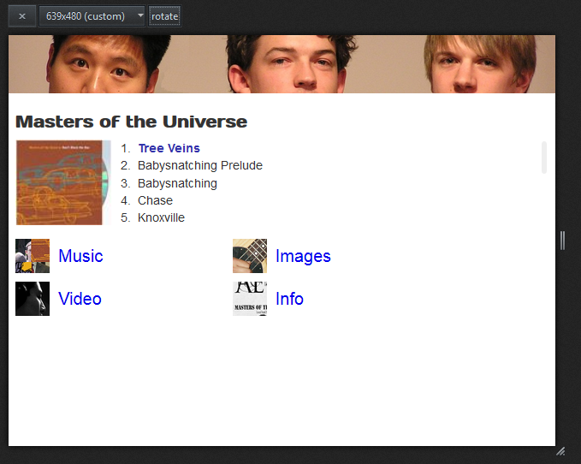
At the breakpoint →
Notes:
At the breakpoint

Slide 54
Step Five: Enhance Layout for Wide Desktop
Position
Type Size
Avoid content islands
Creative use of space

Slide 55
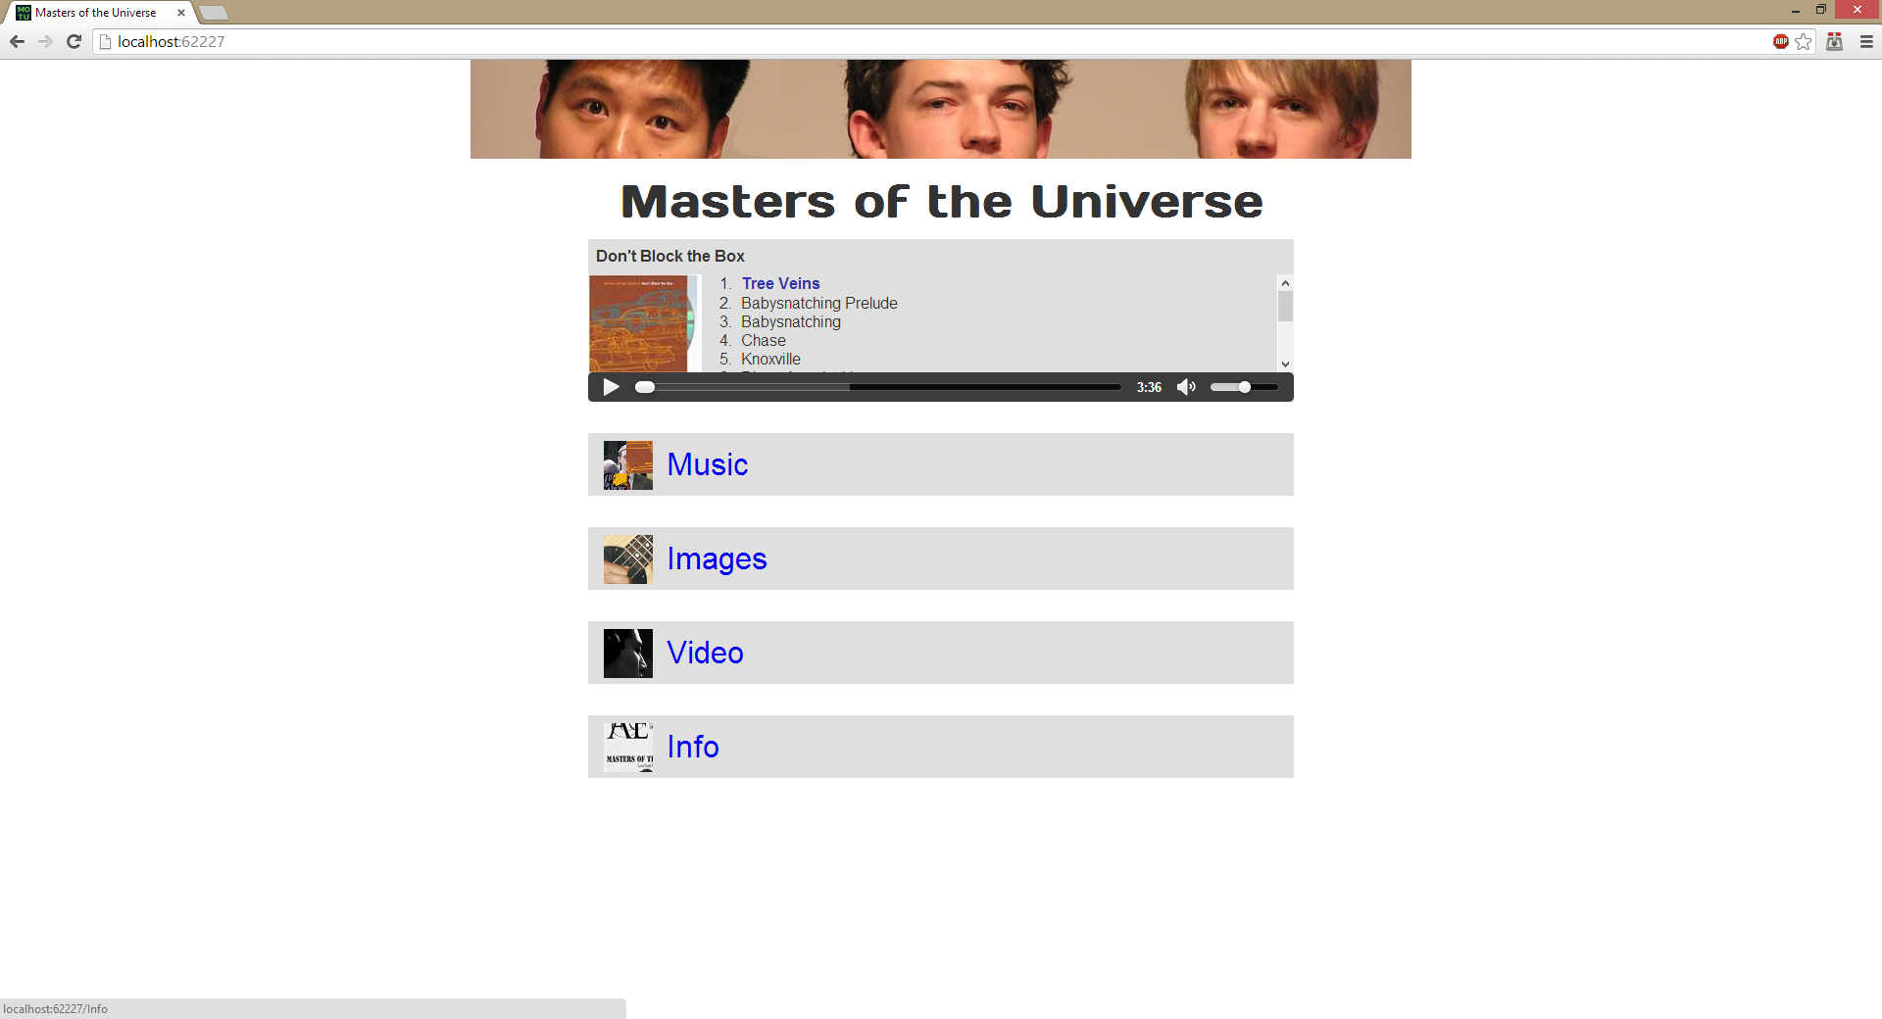

Slide 56
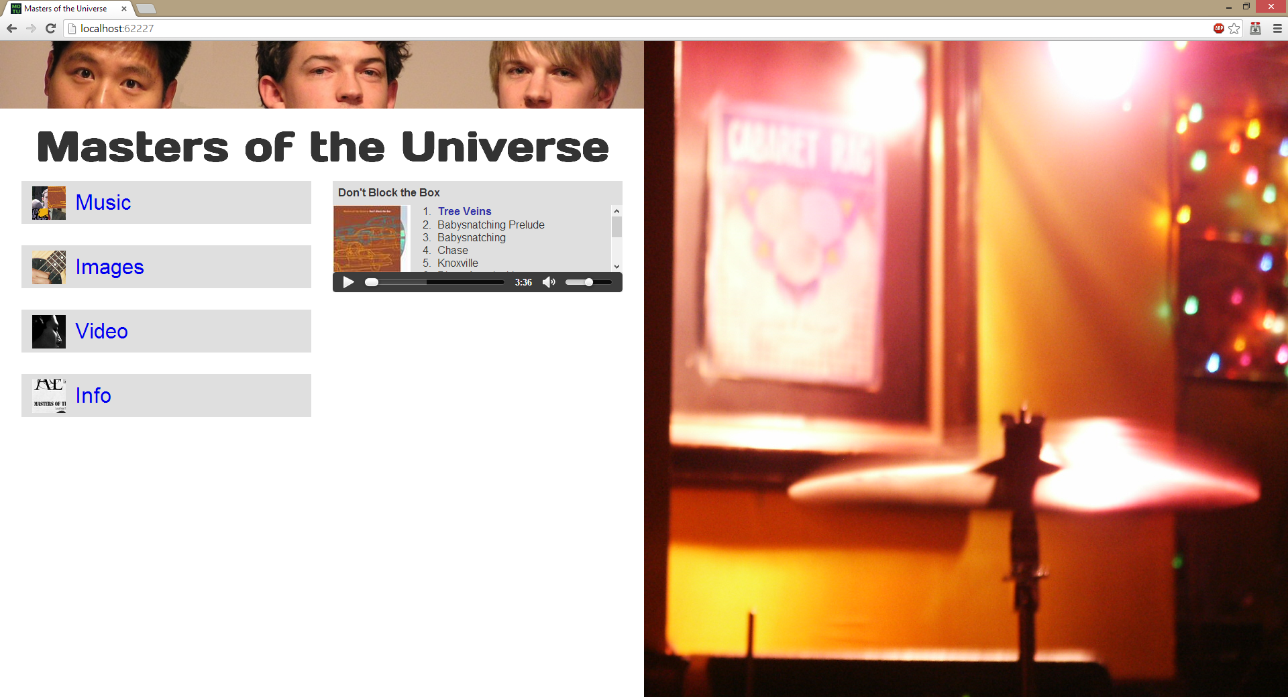

Slide 57
Step Six: Detailed Styling and Interactions
Textures, shadows
Touch, input types
Notes:
All of these can be tuned by device in a bandwidth-friendly manner

Slide 58
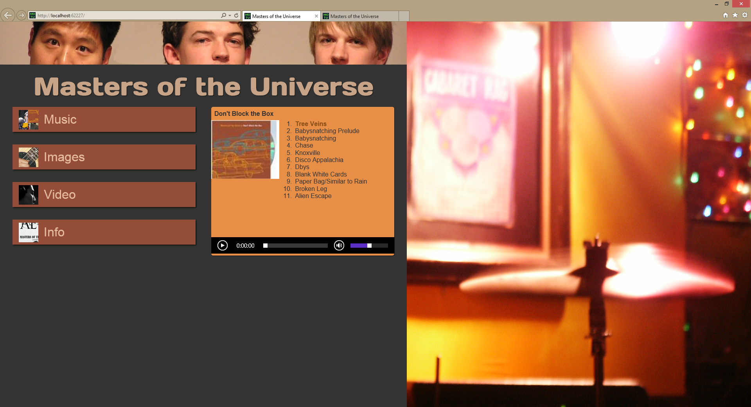

Slide 59
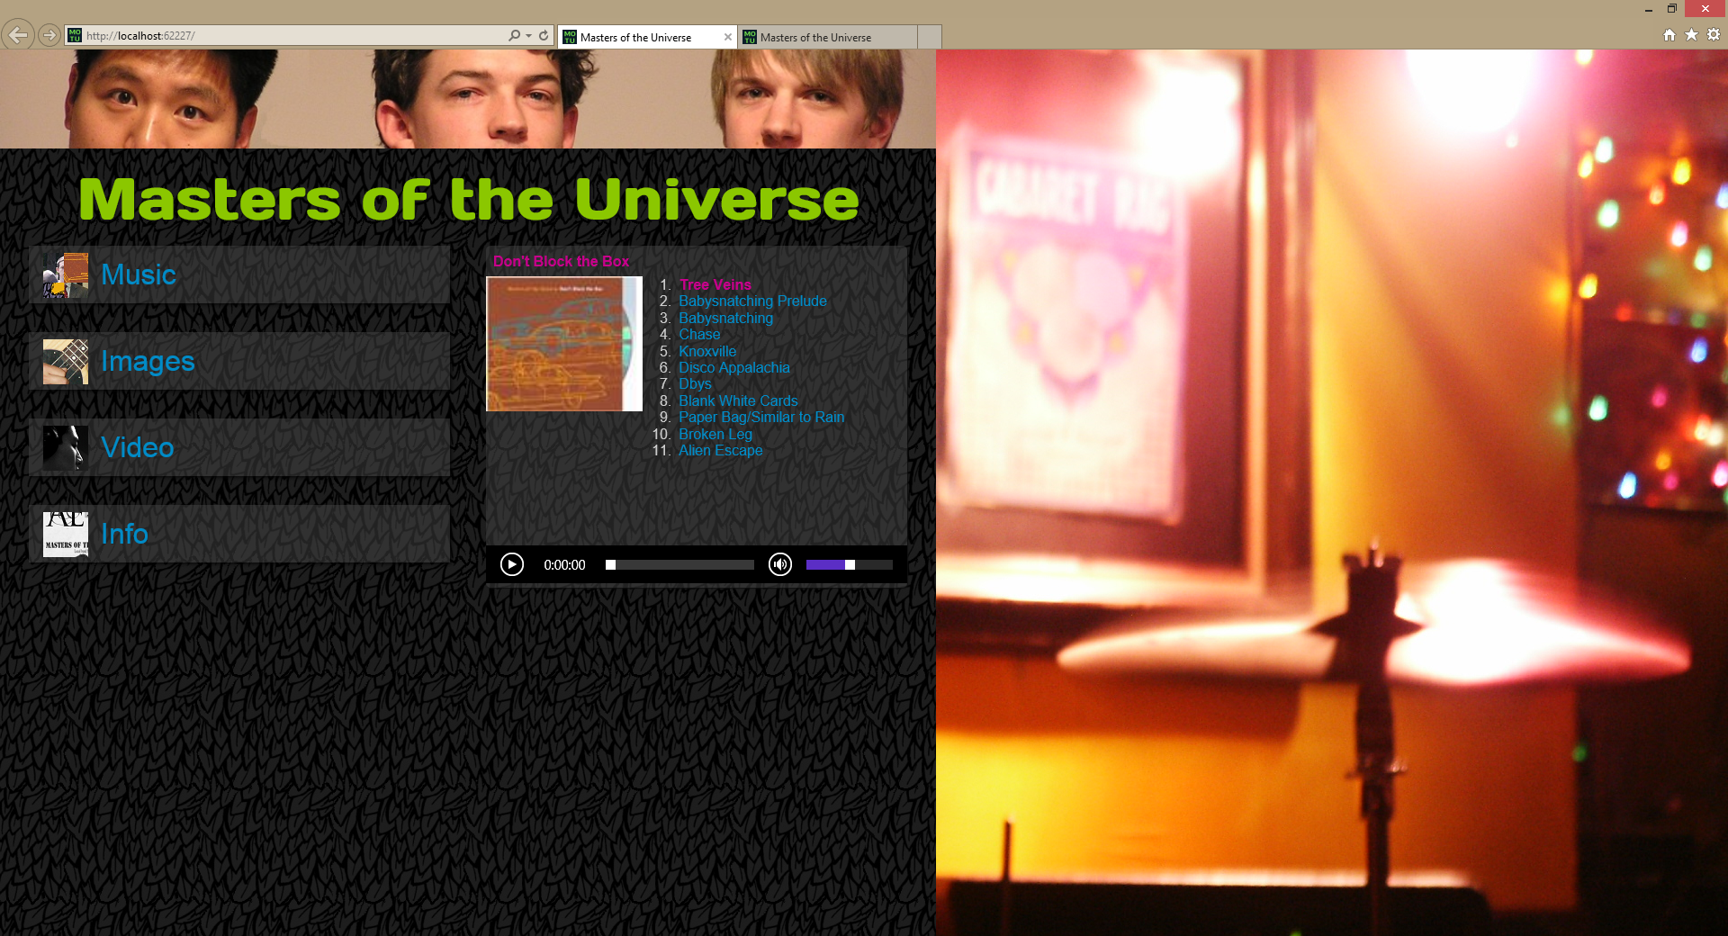
Notes:
Pallette from http://www.colourlovers.com/copaso/ColorPaletteSoftware

Slide 60
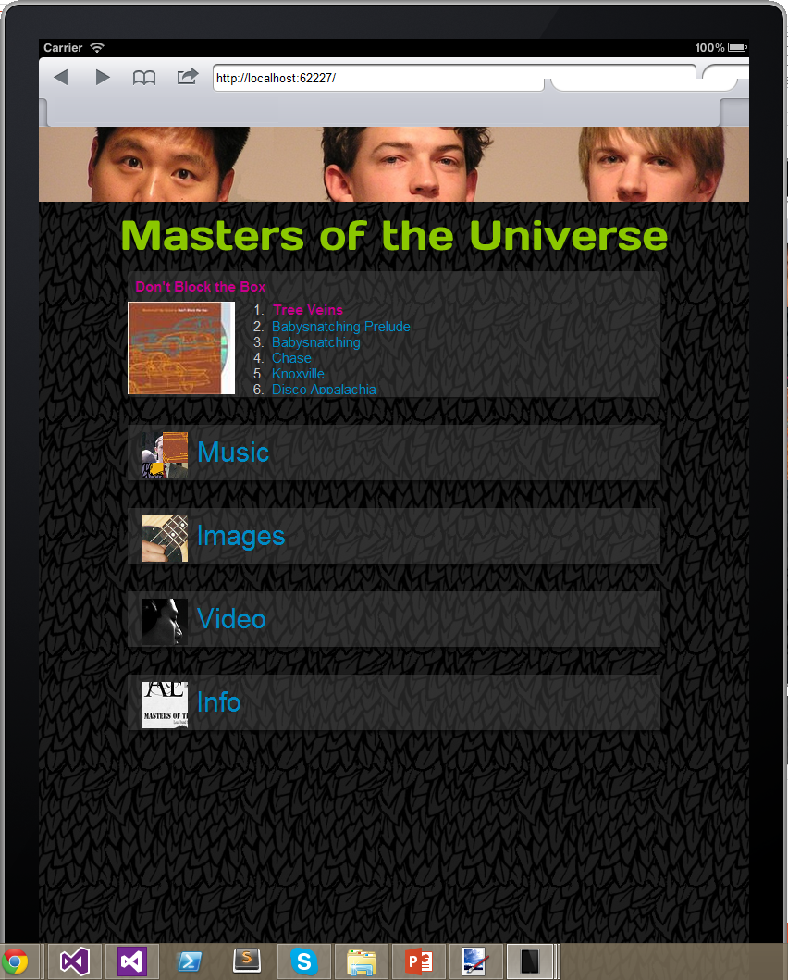
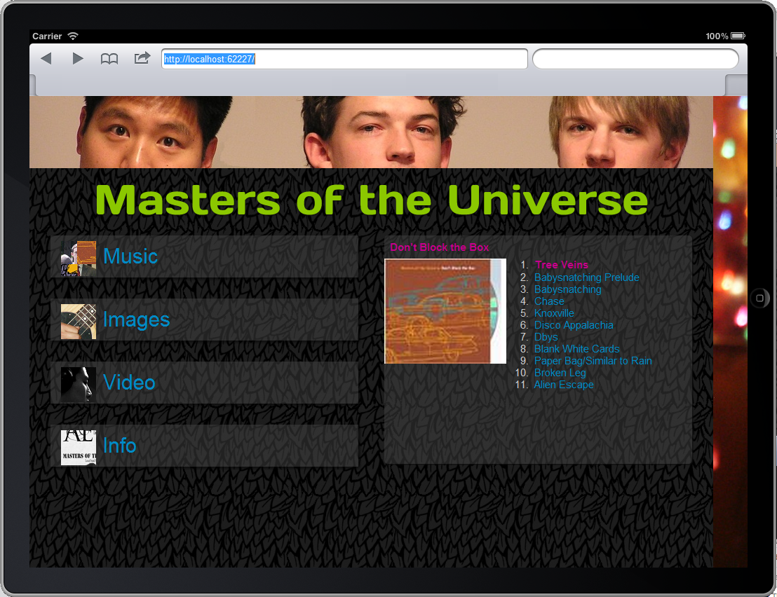
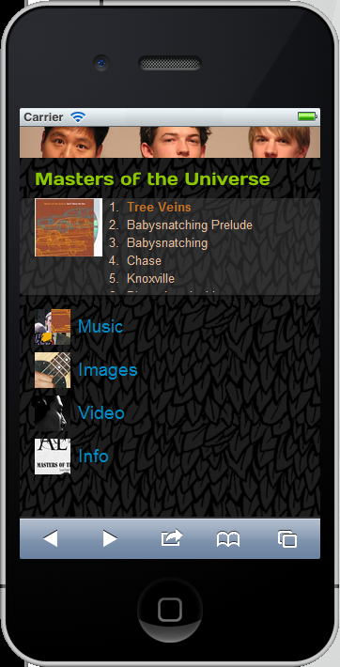

Slide 61
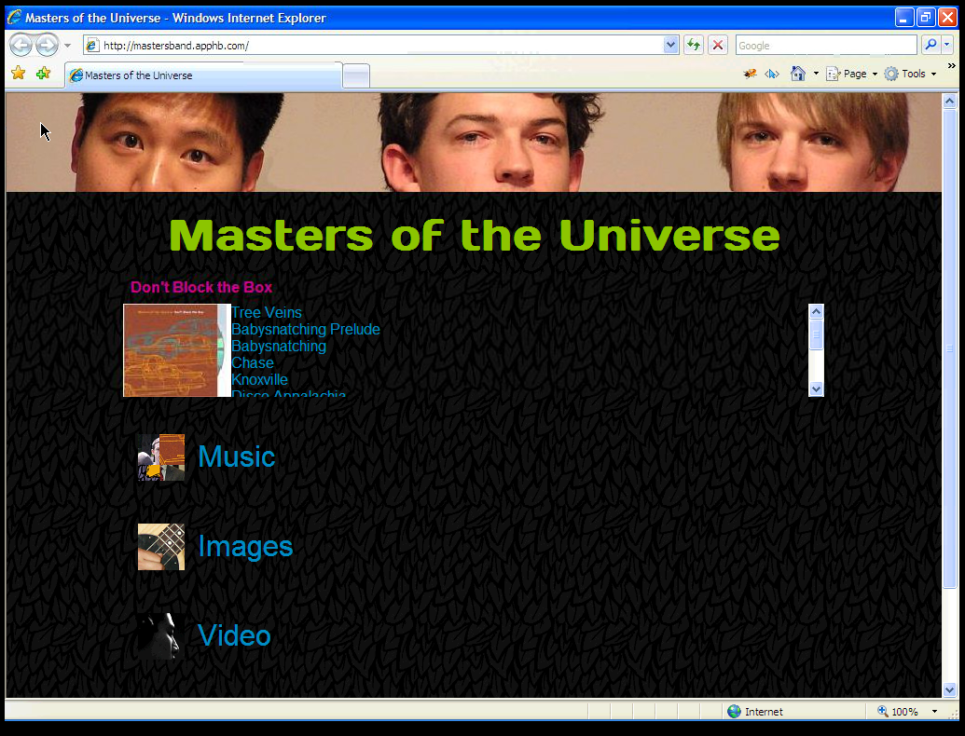
Notes:
XP IE7

Slide 62
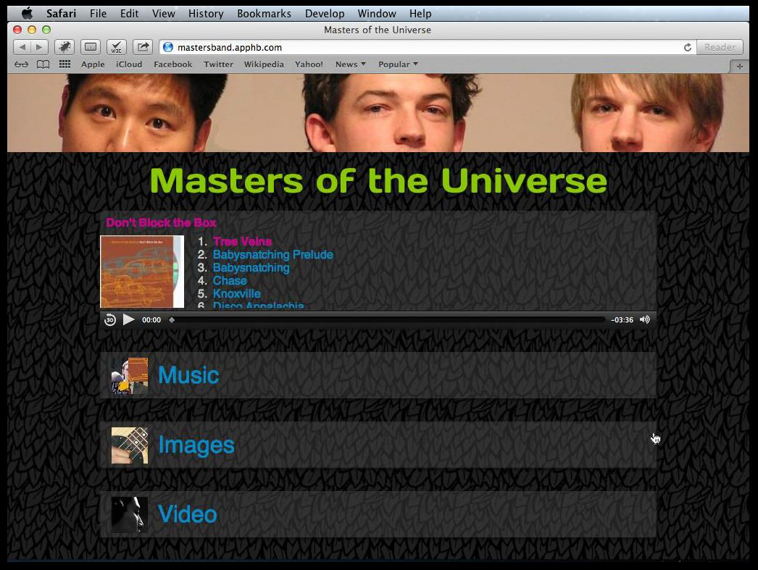
Notes:
Mtn Lion / Safari 6

Slide 63
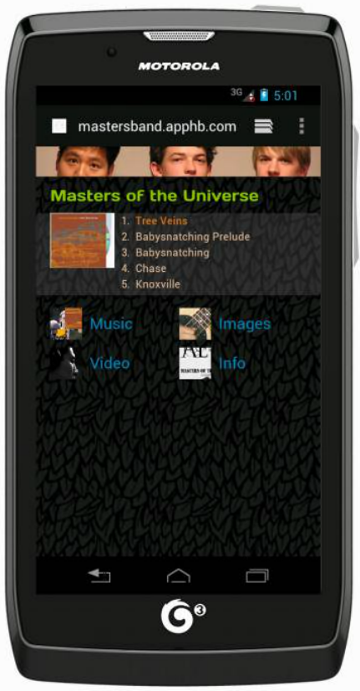
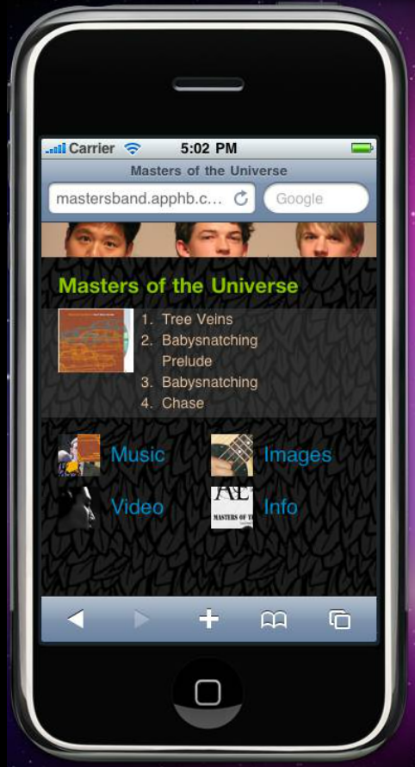


Slide 64
Test, test, test
Testing tools
WatiN / Selenium
Device simulation
BrowserStack
Electric Mobile Studio
Mobilizer
VirtualBox
Simulators will only take you so far
Notes:
http://browserstack.com (http://www.hanselman.com/blog/CrossBrowserDebuggingIntegratedIntoVisualStudioWithBrowserStack.aspx)
http://Springbox.com/mobilizer

Slide 65
Samples
https://github.com/ajryan/CodeCamp2013 (Code)
http://codecampresponsive.apphb.com (Live demos)
http://mastersband.apphb.com (Responsive re-design)

